Slide 1
Montclair Board of School Estimates
2020-2021 Budget Presentation
Presented: March 23, 2020
Dr. Nathan Parker, Interim Superintendent
Mr. Emidio D’Andrea, Business Administrator
Melissa Beattie, Supervisor of Accounting

Slide 2
Board of Education Goals
Goal 1
The Board will be an effective and efficient governance body that establishes and directs the district goals through committee work and bi-monthly meetings.
Goal 2
The Board will assure effective oversight and reporting to monitor progress in meeting student achievement goals and elimination of gaps in achievement by race, ability and/or socio-economic status.
Goal 3
The Board will build the capacity to assure the sound and fiscally responsibility disposition of district resources to achieve its goals in a manner that benefits all students. This will include careful reporting and analysis of systems and programs that affect pupil achievement, including an evaluation of special needs programs, as well as the impact of the quality of services provided.
Goal 4
The Board will hire a permanent Superintendent as well as work to support administration to fill other key open positions with experienced, diverse professionals.

Slide 3
Overall Achievement

Slide 4
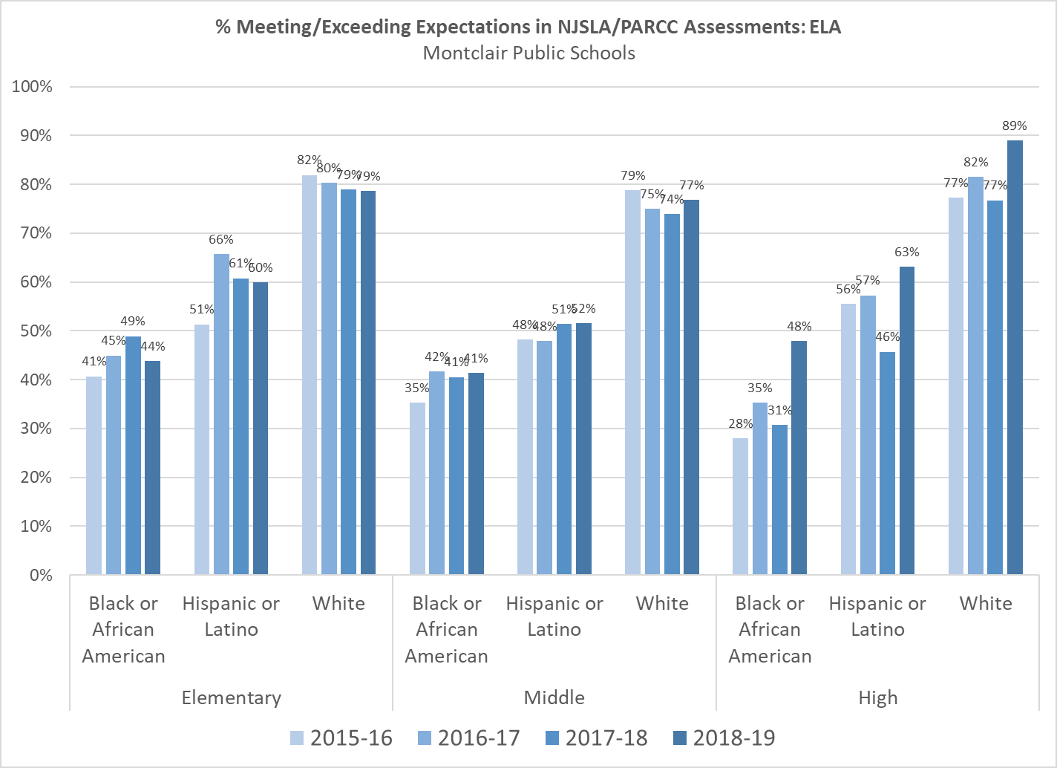

Slide 5
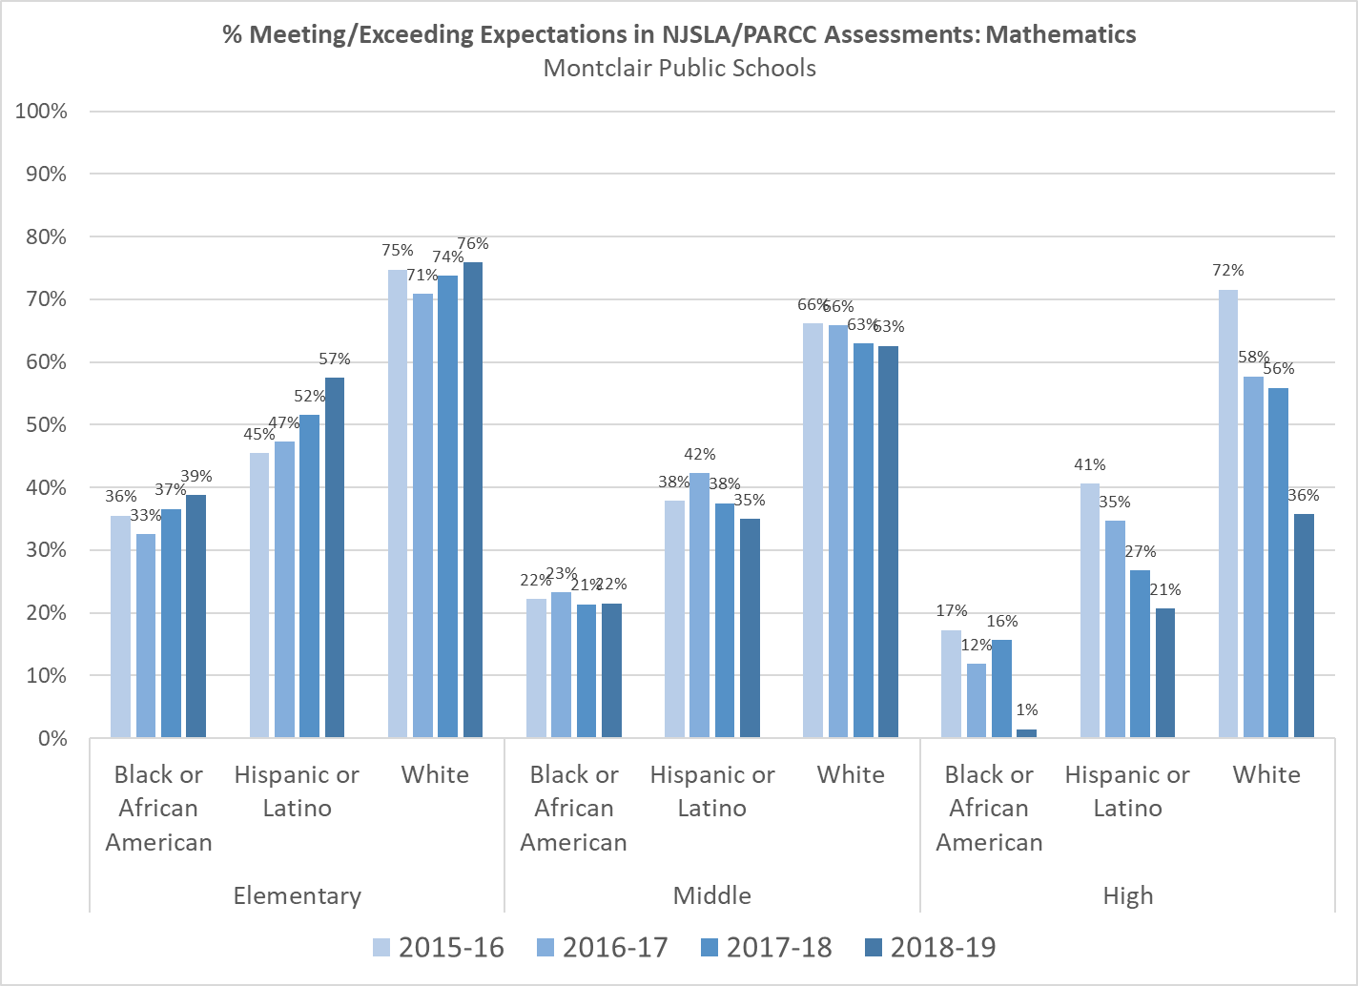

Slide 6
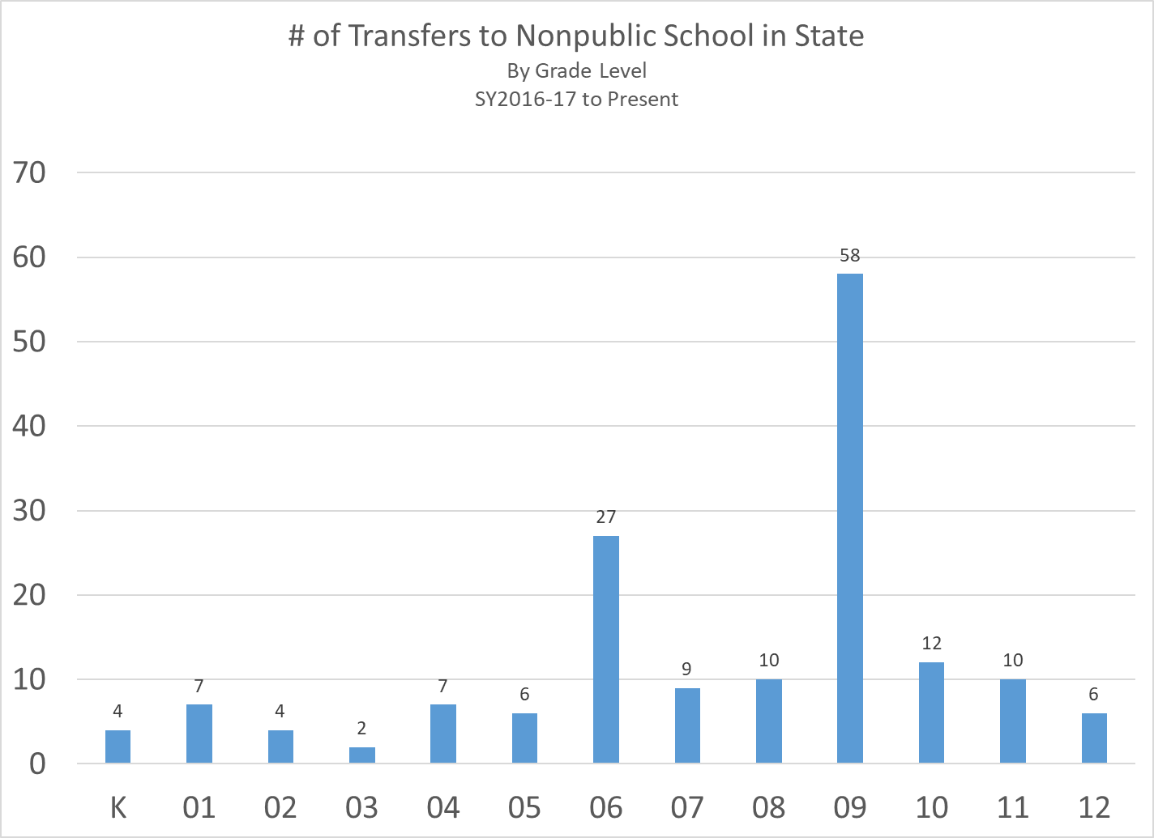

Slide 7
Budget Overview

Slide 8
Budget Goals
Maintain high quality educational services while staying within the 2% tax levy cap
Modify current academic programs to close the achievement gap
Maintain the elementary and middle school magnet themes

Slide 9
Major Drivers of the Budget
Contracted salary increases
The district settled the Montclair Education Association union contract with a 3.5% salary increase for 2020-2021.
The district settled the Montclair Head Custodians Association union contract with a 3.0% salary increase for 2020-2021.
The districted settled with the Montclair Principals Association union contract with a 2.75% salary increase for 2020-2021.
Increases in health benefits
Current projections of the medical cost renewal for 2020-2021 is an increase of 14.25% on the current year cost due to the usage during the last 12 months. The district is working diligently with the Insurance Broker to explore all options and maximize all savings.

Slide 13
Budget Adjustments

Slide 14
Budget Adjustments – New Requests
Expenditure Adjustments | Amount
Removal of New Items Requested for 2020-2021:
Pupil Services Department | $ 59,200
Restructuring of new textbook purchase over 3 years and reduction of supplies and materials | 600,000
Technology Department | 500,000
Charles H. Bullock | 2,574
Glenfield | 7,776
High School | 450,731
Athletic Office | 42,576
Legal Services | 50,000
Judgments | 200,000
Total Removal of New Items Requested for 2020-2021 | $ 1,912,857

Slide 15
Budget Adjustments – Reductions
Expenditure Adjustments | Amount | Expenditure Adjustments | Amount
Personnel/Salary Adjustments | $ 178,852 | Food Service Deficit | $ 20,000
Staffing: |  | Districtwide Purchased Services | 22,000
Secretary | 62,698 | Business Office | 2,000
Operational Aide | 56,020 | Superintendent Office | 2,000
Related Services | 250,875 | Personnel Office | 2,000
Paraprofessionals | 150,000 | Facilities | 200,000
Elementary Schools | 385,000 | Out of District Tuition | 430,501
Middle Schools | 165,000 | Transportation | 535,000
High School | 275,000 | School Resource Officer | 27,000
Administration Restructuring | 199,564 | Pupil Services Department | 10,000
Health Benefits | 1,010,427 | Conference & Travel District Wide | 14,000
Operations & School Support Department | 9,000 | Total Budget Reductions | $ 4,006,937

Slide 16
Estimated District School Tax Levy Increase
Home Valued at $626,906* = $178.67 Estimated District School Tax Increase for 2020
Note: The estimated district school tax increase for every $100,000 of assessed home value is $28.50
* 2019 Average Residential Assessment

Slide 17
Equity Initiatives to Eliminate the Opportunity Gap

Slide 18
Cost Neutral Initiatives
K-12
Improve K-12 instructional and curricular connections across all areas
Expand impact of the Marshall Rubric:
Measure what matters most: engagement, rigor and alignment
Elementary, Middle and High School
Focus classroom support on engagement, rigor and alignment
Pilot a program that reduces the number of mathematics and language arts labs coupled with instructional coaches in mathematics and literacy (elementary and middle schools)
Create sustainable restorative justice in all schools
Create African American academic support teams
Exploring options for student advocacy groups

Slide 19
Initiatives with Potential Budget Impacts (Increases or Decreases)
K-12
Strengthen Student and Family Advocacy
Increase meaningful parent involvement
Increase opportunities for students that are marginalized
Decrease number of students transitioning to private schools
Staff Changes
Align staffing levels more closely with student enrollment and programming
Retirements
Restructuring of roles
Elementary School
Create Director of Elementary Education position
Increase consistency in math, language arts, science, social studies, music and visual arts instruction

Slide 20
Initiatives with Potential Budget Impacts (Increases or Decreases)
Middle School
Glenfield hybrid draft schedule
High School
Create positions of curricular and instructional support
Visual and Performing Arts
Social Studies
STEAM/Science

